Slide 1
Predicting osteoporosis risk
Presented by
SHIBIYA P
NASHIDA

Slide 2
OBJECTIVE
Develop a machine learning model to predict osteoporosis risk using demographic, lifestyle, and health related factors.
Identify patterns and factors associated with osteoporosis risk.
Compare multiple machine learning classification models.
Develop and evaluate a tuned model for reliable risk prediction.

Slide 3
Dataset overview
Dataset size : 1958 records
Original features : 16 columns
Target variable : Osteoporosis
Feature categories :
  Demographic : Age, Gender, Race/Ethnicity
  Lifestyle : Physical Activity, Smoking, Alcohol Consumption
  Health-related : Family History, Calcium Intake, Vitamin D Intake, Prior Fractures
  Medical : Medical Conditions, Medications, Hormonal Changes, Body Weight

Slide 4
Data cleaning & preprocessing
1. Data Cleaning
Checked dataset structure and data types.
Identified missing values and replaced it with “Unknown” where appropriate.
Checked for duplicates.
Investigated repeated IDs.
2. Feature Preparation
Removed ID because it is an identifier, not a predictive feature.
Removed Age Group because it was created only for EDA.
Separated features (X) and target (y) .
3. Encoding & Splitting
Applied One-Hot Encoding to categorical variables.
Split data into 80% training(1566 records) and 20% testing (392 records).
Used stratified splitting to maintain class balance.

Slide 5
Exploratory data analysis (EDA)
Age Distribution :
Age ranged from 18 to 90 years.
Mean age : 39.1 years.
A large proportion of the dataset is in the 18-29 age group.
Target Distribution :
979 records without osteoporosis.
979 records with osteoporosis.
Target classes were perfectly balanced.
Important dataset pattern :
A strong relationship was observed between age and the target variable. In this dataset , all records aged 40 years and above were labelled as having osteoporosis.

Slide 6
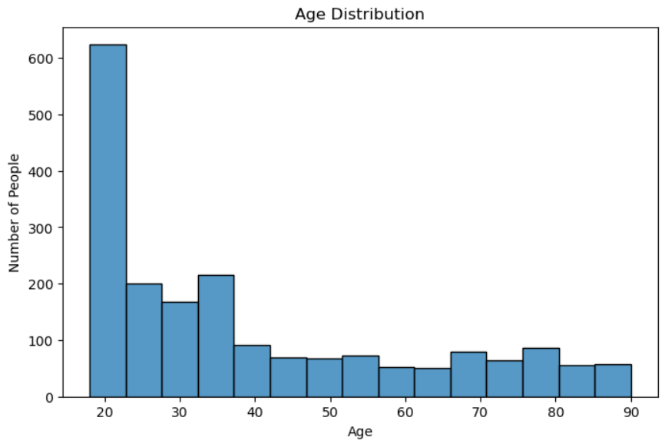
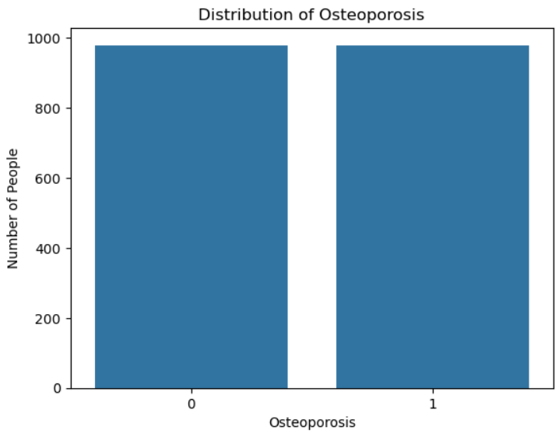
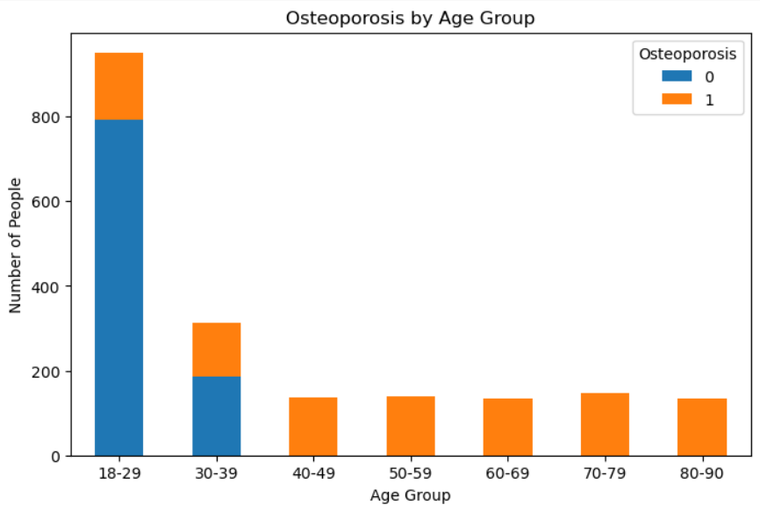
Exploratory data analysis (EDA)

Slide 7
Machine learning models
Four classification models were trained and evaluated to predict osteoporosis risk.
Logistic Regression
Decision Tree
Random Forest
K-Nearest Neighbors (KNN)
Evaluation Metrics :
Accuracy
Precision
Recall
F1-Score
ROC-AUC

Slide 8
Model performance comparison
Model | Accuracy | Precision | Recall | F1-Score
Logistic Regression | 80.9 % | 85.8 % | 74.0 % | 79.5 %
Decision Tree | 81.9 % | 83.8 % | 79.1 % | 81.4 %
Random Forest | 82.9 % | 94.5 % | 69.9 % | 80.4 %
KNN | 83.4 % | 94.6 % | 70.9 % | 81.0 %
Key Observations:
KNN achieved the highest initial test accuracy : 83.4 %
Random Forest achieved the highest initial ROC-AUC : 88.6 %
Decision Tree achieved the highest initial recall : 79.1 %

Slide 9
Cross-validation
5-Fold Cross-validation
Model | CV Accuracy
Logistic Regression | 82.70 %
Decision Tree | 85.25 %
Random Forest | 86.08 %
KNN | 87.29 %

Slide 10
Knn hyper parameter tuning
Method : GridSearchCV with 5-fold cross-validation
Parameters tested:
Number of neighbors :3,5,7,9,11,15,20
Weights : Uniform, Distance
Distance Metric : Euclidean, Manhattan
Best Parameters:
Neighbors : 15
Weights : Uniform
Metric : Euclidean
Tuned CV Accuracy : 88.44 %

Slide 11
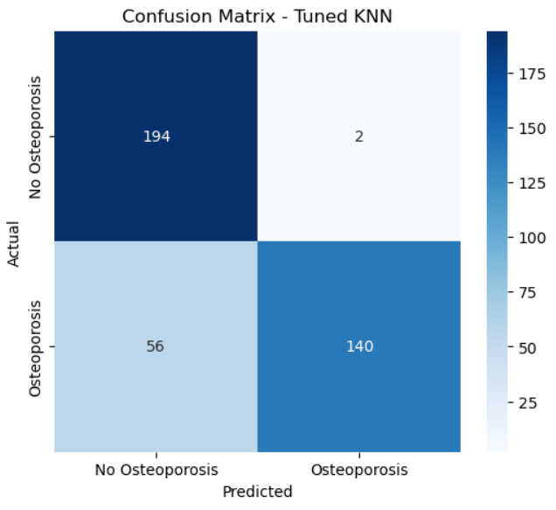
Final model - tuned knn
Selected Model : K-Nearest Neighbors (KNN)
Performance:
Metric | Result
Test Accuracy | 85.20 %
Precision | 99 %
Recall | 71 %
F1-Score | 83 %
ROC-AUC | 87.63 %
5-Fold CV Accuracy | 88.44 %

Slide 12
key findings
Age was the most influential feature in the Random Forest model.
Age accounted for approximately 64.6 % of the model’s feature importance.
Other individual features had much smaller important values.
This finding is consistent with the strong age-target relationship observed during EDA.
Feature importance indicates how the Random Forest model used the features. It does not prove that a feature causes osteoporosis.

Slide 13
Limitations & potential applications
Limitations
Strong age-target relationship : All records aged 40 + were labelled as having osteoporosis.
Dataset size : Only 1958 records were available.
Generalizability : Results may not represent other populations or datasets.
Recall : The final KNN model had 71 % recall , meaning some actual osteoporosis cases were missed.
Clinical validation : The model has not been clinically validated.
Potential Healthcare Application
Support early risk identification.
Help identify individuals who may need further assessment.
Support preventive follow-up decisions.
Could serve as a decision-support tool after proper validation

Slide 14
conclusion
Project Summary
Developed an end-to-end machine learning classification model for osteoporosis risk prediction.
Performed data cleaning, EDA, preprocessing, encoding and model evaluation.
Compared four models : Logistic Regression, Decision Tree, Random Forest and KNN.
Used 5-fold cross-validation and GridSearchCV to improve model evaluation and tune KNN.
Selected Tuned KNN as the final model.
Final model Performance:
85.2% Test Accuracy
99% Precision
71% Recall
83% F1-Score
87.6% ROC-AUC
88.4% 5-Fold CV Accuracy

Slide 15
Thank you

